Slide 1


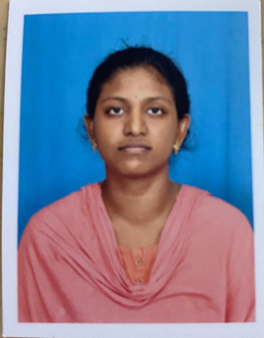

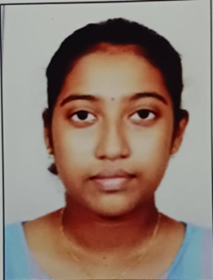
KisanConnect: A Unified Smart Service Platform for Farmers and RSK
VR SIDDHARTHA ENGINEERING COLLEGE, VIJAYAWADA
Department of Computer Science and Engineering
23CS5554: EPICS (Review-1)
Date :17-11-25
Batch No:16
Batch Members
Under the Guidance of
Mrs.K.Sree Vijayalakshmi,
M.Tech, (Ph.D),
Assistant Professor
Mamidi Tuhi Inala Jaswanth Naidu T.V.N.G. Swetha
248W5A0505 238W1A0520 238W1A0559

Slide 2
1. Abstract:
Agriculture remains the backbone of rural India, yet farmers continue to face challenges in accessing timely information, essential agricultural inputs, and government welfare benefits. The Government of Andhra Pradesh has launched Rythu Seva Kendras (RSKs) for farmer welfare. Rythu Seva Kendra is a place where farmers can get the necessary seeds, fertilizers, and other assistance. Here, all the requirements of farmers can be fulfilled. Farmers can access fertilizers and seeds at low cost and also receive other assistance, such as applying for government schemes. However, farmers from distant places have to visit the Rythu Seva Kendras in person. Until farmers physically visit the RSK office, there is no means of knowing whether the required fertilizers are available or whether the office is open. There is no platform to connect RSK staff and farmers. To reduce gap between RSK staff and farmers a app is proposed. This system reduces the need for frequent visits to RSKs, as all communication takes place through the application. The app simplifies the work of both RSK staff and farmers. Farmers can access stock details and information about the latest government schemes. It also allows farmers to request required fertilizers and pesticides online instead of making manual visits. The data is also available to farmers in offline mode. The RSK staff can make use of this app to monitor stock and sales data digitally, replacing the need for maintaining hard copies of records.
Key Words:
KisanConnect, Rythu Seva Kendra, Agricultural Digital Platform, web scrap , offline access.

Slide 3
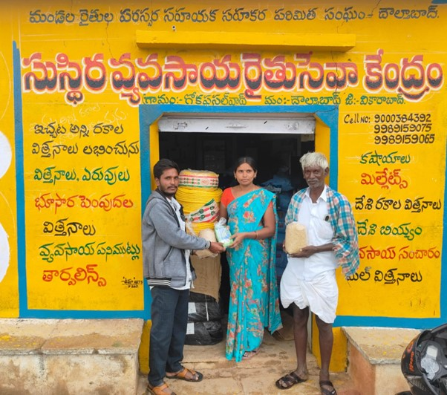
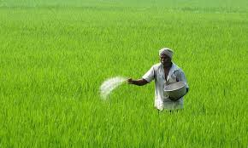
2.Motivation
Farmers often face difficulties in accessing timely information about government schemes, subsidies, and agricultural inputs.
There is no single digital platform that connects farmers directly with Rythu Seva Kendras (RSKs) for information and services.
Farmers require a system that supports local languages and simplified interaction, ensuring inclusiveness for all literacy levels.
The motivation behind this project is to bridge the gap between farmers and RSKs through a smart, unified, and accessible digital solution that promotes efficiency and empowerment in agriculture.

Slide 4
3. Objectives of the Project
To enable farmer access to agricultural services, government schemes in offline mode also.
To Provide real-time inventory updates for seeds, fertilizers, and pesticides, market access.
To Develop a unified digital platform to act as an intermediary between RSKs and farmers.

Slide 5
4. Scope
The scope of this app covers all requirements for the RSK in Poranki .
RSK staff can only monitor stock and sales data through the mobile app.
Farmers can view the availability of seeds, fertilizers, pesticides, and other agricultural inputs at their RSKs and this information is available in offline mode.
The app supports only English and Telugu languages.

Slide 6
5. Title Justification
“KisanConnect” shows that the platform connects farmers with Rythu Seva Kendras (RSKs).
The title highlights easy communication and access to services for farmers.
“Unified Platform” means all services are available in one place instead of multiple sources.
“Smart Service” indicates the use of digital tools and technology to improve efficiency.
The title clearly states that both Farmers and RSKs are the main users of the platform.
It reflects the goal of making agricultural services simple, accessible, and well-organized.

Slide 7
6. Literature Survey-1
Title: FARMERS ASSISTANT WEB APPLICATION
Journal Details: International Research Journal of Modernization in Engineering Technology and Science, Volume:07/Issue:03/March-2025
Description:
The Farmer Assistant Application is a comprehensive digital platform designed to support farmers by providing crucial agricultural insights and services. It integrates crop prediction using machine learning models to help farmers optimize their yield based on soil conditions and historical data. The application offers real-time weather updates to assist in decision-making regarding irrigation and harvesting. Additionally, it provides information on government subsidies, ensuring farmers are aware of financial aid and schemes available to them. A labor-finding feature connects farmers with agricultural workers, addressing workforce shortages.
Observations:
Automating and centralizing agricultural information saves time and reduces the cost of operations..
Keeps farmers informed about subsidies, grants, and welfare programs, helping them receive financial support easily.
Scope:
Many rural areas lack stable internet, limiting app accessibility and real-time data updates.
Developing and maintaining the platform, along with training farmers, may involve high initial costs.

Slide 8
6. Literature Survey-2
Title: SMART-AGRI CONNECT: An Integrated Platform for Farmers Utilizing ML-Driven Recommendations and Real-Time Tracking
Journal Details:2025 International Conference on Knowledge Engineering and Communication Systems (ICKECS)Description
Description: The agricultural sector faces numerous challenges, including limited market access, inefficient supply chains, and inadequate platforms for farmers to showcase and sell their products. To address these issues, this paper explores the development of an integrated mobile application designed specifically for farmers. The app aims to combine the functionalities of e-commerce, social media, marketing, and news into a single platform, enabling farmers to build customizable profiles, manage inventory, and directly connect with consumers and businesses. It integrates tools such as an interactive map for locating nearby farmers and their products, Artificial Intelligence/Machine Learning- driven recommendations, and flexible selling options without traditional weight limitations.
Observation:
1. Combines marketing, and news—offering farmers multiple services in one app.
2. Allows farmers to manage stock, track availability, and reduce waste caused by unsold produce.
Scope:
Rural areas may have poor internet access, limiting consistent app usage.
Farmers and staff might need training sessions to fully utilize all features of the app.

Slide 9
6. Literature Survey-3
Title: A Farmer Assistance Smartphone Application with Crop Planner, Crop Disease Help, Agri-expert Search, and Crop Suggestion Features
Journal Details:2024 IEEE International Conference
Description:
Farmers contribute significantly to a country’s food security by producing fresh fruits and crops. Farmers are no longer profitable from crop cultivation due to a lack of funding, inadequate crop cultivation support from the government, rising crop cultivation costs, and frequent natural disasters. Previous farmer assistance papers did not include the development of an intelligent ICT-based smartphone application for farmers, which included an online crop selling feature, seed and fertilizer search, weather information, crop care alert, agri-expert search, agriculture training, farmer loan application, crop price listing, and crop seller store search feature.
Observation:
Combines multiple farming services (crop selling, weather updates, training, etc.) in a single app, reducing the need for multiple tools.
Provides instant weather alerts, crop disease notifications, and fertilizer recommendations for better decision-making.
Scope:
Some features like live crop selling or real-time expert consultation require stable internet connectivity.
Farmers with limited smartphone or app knowledge may find it difficult to use advanced features initially.

Slide 10
6. Literature Survey-4
Title: Reflecting real-time monitoring of Agricultural equipment in Rythu Bharosa Kendra
Journal Details:2024 IEEE International Conference
Description:
The RBK, an initiative by the Andhra Pradesh government, seeks to bolster farming communities by supplying quality seeds, fertilizers, and agricultural supplements while offering vital extension advisories at the village level. To modernize their operations, a proposed automated system will replace manual record-keeping by storing data directly into a database, facilitating seamless facility transactions, and generating comprehensive service reports. By outfitting RBK vehicles with GPS devices and integrating React technology for a user interface, administrators gain real-time insights into vehicle movements, optimize routes, and efficiently monitor the distribution of agricultural resources.
Observation:
Manual paperwork is replaced with a centralized database, reducing errors and saving time.
2. Every transaction and distribution detail is digitally recorded, minimizing the chances of corruption or misuse of resources.
Scope:
Staff may require training to operate and maintain the automated system effectively.
Traditional workers may be reluctant to adopt new technology or shift from manual practices.

Slide 11
6. Literature Survey-5
Title: Mobile Application for Fertilizers Stock & Sales Monitoring for RBK
Journal Details: Grenzer International Journal of Engineering and Technology,2023
Description:
RBKs are the places for assisting the farmers like provide seeds, fertilizers, pesticides and also maintain record on farmers.. Village Officers at RBKs maintain a hard copy record of their field review reports and availability of fertilizers and quantity of crops. Having an app or a website to store their record and also finding a nearer RBK's for them would be beneficial, so that higher officials like agricultural Officers can get a detailed timely idea of how’s the RBK sales are serving the farmers
Observation:
1. They also assist farmers in locating markets for their goods.
2. Maintain stock like seeds, fertilizer, pesticide data in app.
Scope:
1. A high level of knowledge is required by farmers to understand every portion of the app.
2. Some of the data on mobile phones is complicated and so difficult to understand.

Slide 12
6. Literature Survey-6
Title: SMART KISAN: A Mobile App for Farmers' Assistance in Agricultural Activities
Journal Details: 2023 International Conference on Smart Systems for applications in Electrica
Description:
Farmers in India face various challenges during the crop cycle, including a lack of knowledge about the latest technologies, practices, and disease identification and management. Additionally, farmers often struggle to find appropriate storage facilities and determine fair market prices for their produce. To address these issues, a digital solution is proposed in the form of a mobile application for farmers. The application includes six features: a technology library, plant disease identification and diagnosis, an automated chatbot for answering questions, weather alert information, information on nearby warehouses and market prices for produce. The app is designed to provide farmers with the necessary tools to address their problems independently, including multilingual support.
Observation:
Helps farmers from different regions overcome language barriers, increasing accessibility and usability.
Weather alerts help farmers make better decisions.
Scope:
Farmers without smartphones or internet access may not benefit from the application.
Some farmers may find it difficult to use digital features like chatbots or disease detection tools without proper training.

Slide 13
6. Literature Survey-7
Title: Mobile Applications Empowering Smallholder Farmers: A Review of the Impact on Agricultural Development
Journal Details: International Journal of Social Analytics 2023
Description:
The mobile apps have facilitated real-time access to relevant agricultural information, including weather updates, crop prices, best farming practices, and pest management techniques. The availability of reliable information enables farmers to make informed decisions, leading to enhanced productivity and better crop yields. Additionally, these apps provide price transparency, allowing farmers to negotiate better prices for their produce, leading to improved income and capturing a larger share of the market value for their products. The research also highlights the financial services offered by mobile applications in developing countries, such as mobile banking and digital payment solutions.
Observation:
1. Optimizing Resource Management.
2. Enhancing Financial Inclusion.
Scope:
1. limited access to a stable internet connection.
2.Languague barrier i.e., within local language is not available.

Slide 14
6. Literature Survey-8
Title: Android App to Connect Farmers to Retailers and Food Processing Industry
Journal Details: : 2018 3rd International Conference on Inventive Computation Technologies (ICICT)
Description:
The mobile application is intended to be used for fast and updated information delivering system for farmers. Also, it has native language support to make the transaction easy for farmers. The mobile application treats farmers as a seller and a buyer. The intention behind this paper is to help farmers so they buy or sell their agriculture goods and products. Market prices provided by data.gov.in lets the system to keep the selling and buying prices in control. As the products are to be browsed and there may be plenty of products for the user. To make browsing easy many filters can provide. Farmers face many problems while selling their goods and products, this system promises to provide an easy and recreational way to sell the products. The system lets the farmers to sell goods at a reasonable price and makes business even fair and transparent.
Observation:
Market prices are updated online, helping farmers make smart decisions.
The app is easy to use and supports local languages.
Scope:
Poor internet connection in villages can limit use.
Prices and data must be updated regularly to stay accurate.

Slide 15
Summary of existing implementations
S. No. | Article Title | Journal/conference Details | Advantages | Scope
1 | FARMERS ASSISTANT WEB APPLICATION | International Research Journal of Modernization in Engineering Technology and Science,Volume:07/Issue:03/March-2025 | 1.Automating and centralizing agricultural information saves time, reduces costs, and keeps farmers informed about subsidies. | 1.Many rural areas lack stable internet, limiting app accessibility and real-time data updates.
2 | SMART-AGRI CONNECT: An Integrated Platform for Farmers Utilizing ML-Driven Recommendations and Real-Time Tracking | 2025 International Conference on Knowledge Engineering and Communication Systems (ICKECS)Description | 1.Combines marketing, and news—offering farmers multiple services in one app. 2.Allows farmers to manage stock, track availability. | 1.Poor internet connectivity in rural areas may limit app usage, and users may require basic training to utilize all features effectively.
3 | A Farmer Assistance Smartphone Application with Crop Planner, Crop Disease Help, Agri-expert Search, and Crop Suggestion Features | 2024 IEEE International Conference | 1.Combines marketing, and news—offering farmers multiple services in one app. 2.Allows farmers to manage stock, track availability, and reduce waste caused by unsold produce. | 1.Some features like live crop selling or real-time expert consultation require stable internet connectivity. 2.Farmers with limited smartphone or app knowledge may find it difficult to use.

Slide 16
Summary of existing implementations
S. No. | Article Title | Journal/conference Details | Advantages | Scope
4 | Reflecting real-time monitoring of Agricultural equipment in Rythu Bharosa Kendra | 2024 IEEE International Conference | 1.Replaces manual paperwork with a centralized database to reduce errors. 2.Digitally records all transactions and distributions, ensuring transparency. | 1.Staff may need training to efficiently operate and maintain the automated system. 2.Traditional workers might resist adopting new technology and moving away from manual practices.
5 | Mobile Application for Fertilizers Stock & Sales Monitoring for RBK | Grenzer International Journal of Engineering and Technology,2023 | 1. They also assist farmers in locating markets for their goods. 2. Maintain stock like seeds, fertilizer, pesticide data in app. | 1. A high level of knowledge is required by farmers to understand every portion of the app. 2. Some of the data on mobile phones is complicated
6 | SMART KISAN: A Mobile App for Farmers' Assistance in Agricultural Activities | International Journal of Social Analytics 2023 | 1.Enables farmers from different regions to overcome language barriers, improving and usability. 2.Provides weather alerts to help farmers make informed agricultural decisions. | 1.Farmers without smartphones or internet access may be unable to use the application. 2.Some farmers may struggle with digital features like chatbots without adequate training.

Slide 17
Summary of existing implementations
S. No. | Article Title | Journal/conference Details | Advantages | Scope
7 | Mobile Applications Empowering Smallholder Farmers: A Review of the Impact on Agricultural Development | International Journal of Social Analytics 2023 | 1. Optimizing Resource Management. 2. Enhancing Financial Inclusion. | 1. limited access to a stable internet connection. 2.Languague barrier i.e., within local language is not available.
8 | Android App to Connect Farmers to Retailers and Food Processing Industry | 2018 3rd International Conference on Inventive Computation Technologies (ICICT) | 1.Market prices are updated online, helping farmers make smart decisions. 2.The app is easy to use and supports local languages. | 1.Poor internet connection in villages can limit use. 2.Prices and data must be updated regularly to stay accurate.

Slide 18
Summary of existing implementations
Existing Systems:
Most agricultural information systems are designed primarily for agricultural officials, not farmers.
The platforms often have complex interfaces that make them difficult for farmers to use.
Existing systems mainly focus on maintaining stock details such as fertilizers, seeds, and pesticides.
Most existing systems require continuous internet connectivity, which becomes a major limitation in rural areas with poor network coverage.
Uniqueness of our solution:
Our proposed solution creates a single platform useful for both officials and farmers.
The system is easy to use, supports local languages, and includes a voice assistant for better accessibility.
Officials benefit by being able to maintain schemes, manage stock information efficiently.
A major feature of the system is offline mode, which allows farmers to access essential data even without an active internet connection

Slide 19
7. Summary of Design Thinking Findings
Empathize
Talk to farmers about their struggles in accessing fertilizer/pesticide info.
Identify whether they need stock details, government schemes,
Example Insight: Farmers lack a single platform to check fertilizer availability & scheme eligibility.
Define
There is no unified digital platform connecting farmers and RSKs for transparent communication, real-time information, efficient requests, and AI-based agricultural advisory.”
Define core features: Fertilizer info, scheme categorization stock request option.
Ideate
A unified platform for farmers to access fertilizer and pesticide stock details, government schemes.
A simple request form allowing farmers to directly send queries or requests to their nearest RSK or agricultural officer.
Offline functionality to ensure access to previously loaded data , even in rural areas with unstable connectivity.

Slide 20
7. Summary of Design Thinking Findings
Prototype
Dashboard contains the statistics of (Fertilizers | Pesticides | Schemes) and classification of Central and State Schemes.
Request form for farmers to send their request.
Test
Show the prototype to a group of farmers or RSK staff.
Refine interface according to the feedback given by the farmers and rsk staff.

Slide 21
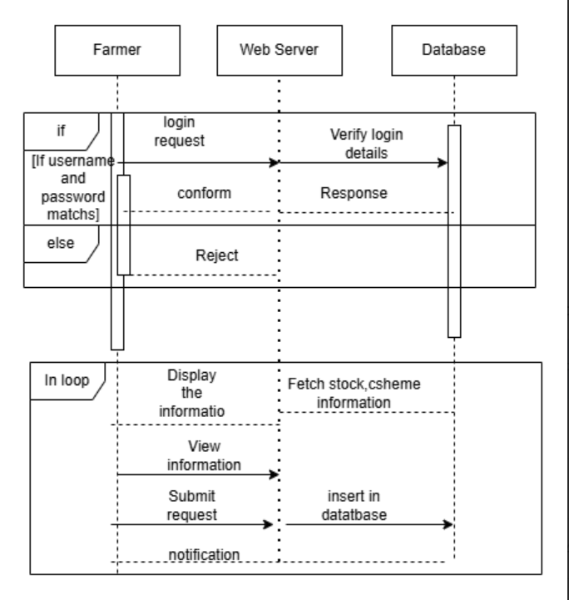
8.UML Diagrams
Sequence Diagram
Farmer Interface

Slide 22
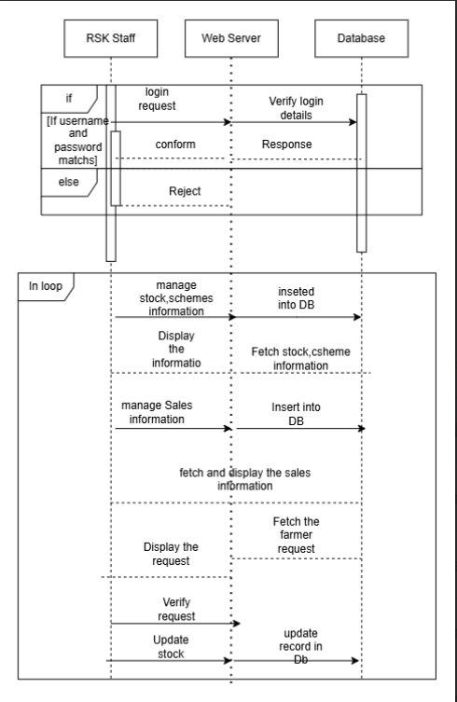
8.UML Diagrams
Sequence Diagram
RSK Interface

Slide 23
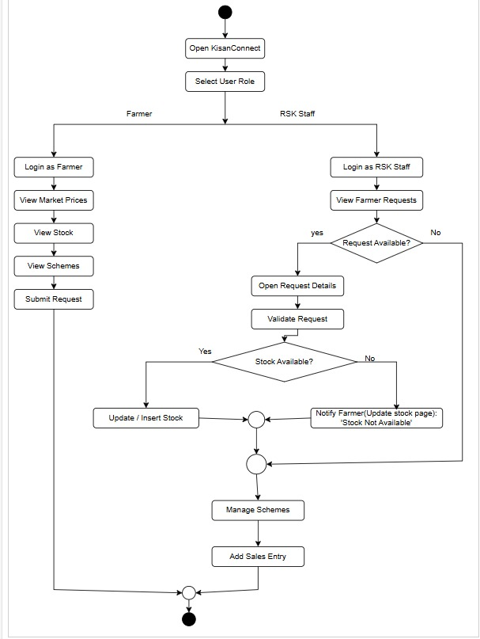
8.UML Diagrams
Activity Diagram

Slide 24
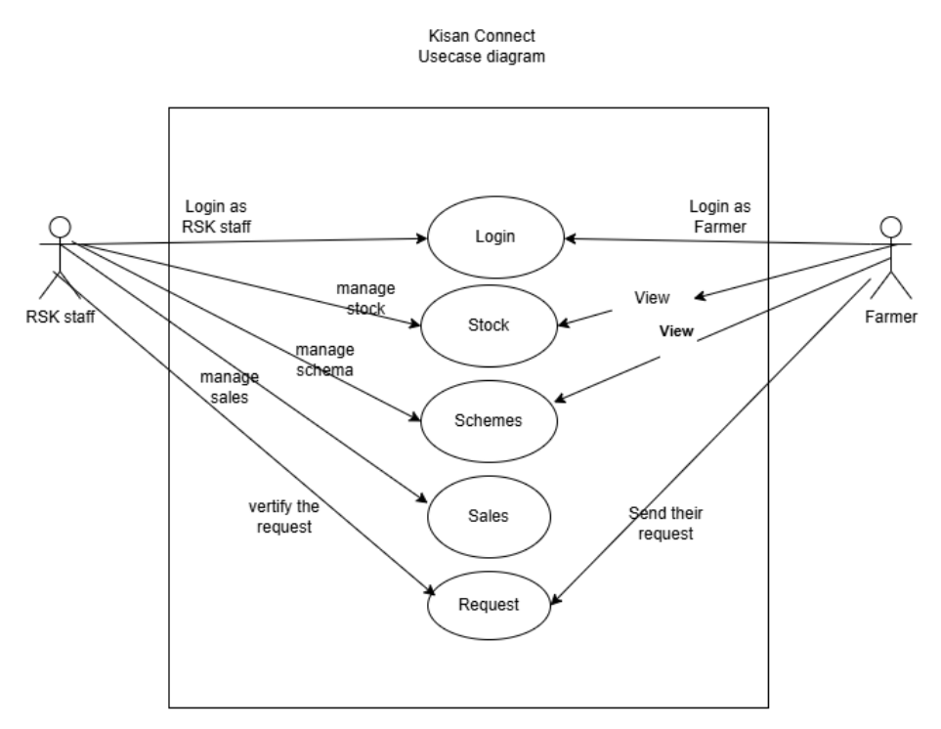
8.UML Diagrams
Usecase Diagram

Slide 25
9.Functional and Non-Functional Requirements
Functional Requirements
Non-Functional Requirements
S.No | Functional Requirements
1 | Role-Based Access Control for Different User Type
2 | User Authentication (Login, Logout, Password Reset)
3 | Data Entry & Validation for Forms
4 | CRUD Operations (Create, Read, Update, Delete)
5 | voice assistant
6 | Offline accessibility
7 | Multiple languages
S.No | Non-Functional Requirement
1 | Security – Access Control
2 | Usability – Simple and Intuitive User Interface
3 | Portability – Works on any Platforms example android, IOS
4 | Reliability – Consistent Operation Without Failures
5 | Maintainability – Easy to Debug and Enhance

Slide 26
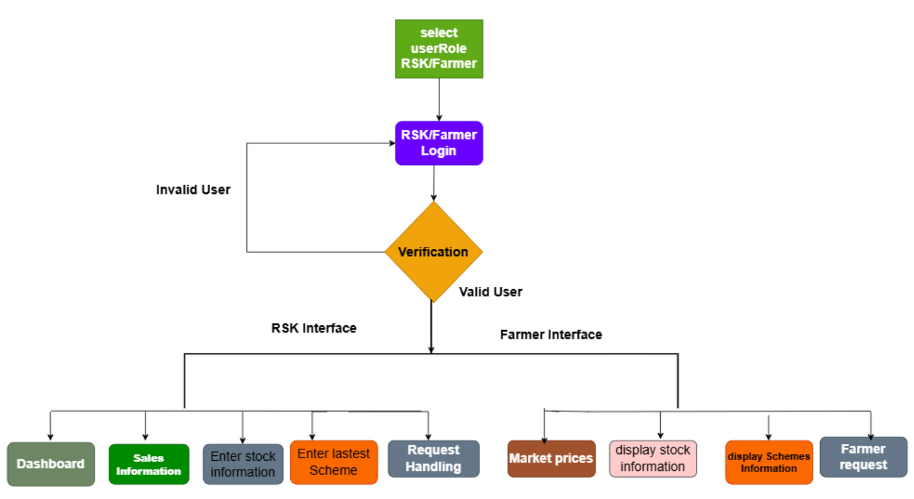
10. Proposed Approach Block Diagram

Slide 27
11. Kisan Connect-Methodology
This app have two kinds of users Farmers and RSK staff.
The user initially select their role.
The forward to login page and their give their credentials to login.
On entering into their screen can perform their task.
Modules:
Dashboard/Home page
Stock Management
Scheme Management
Request Handling
Sales

Slide 28
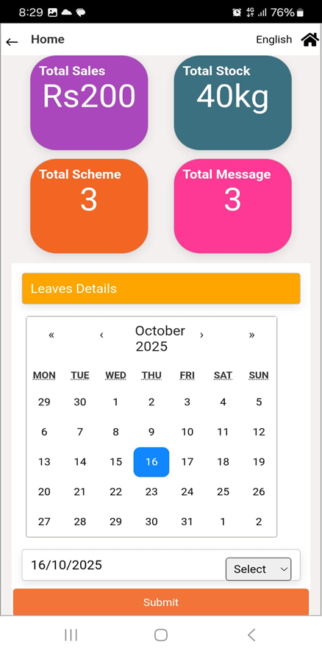
11.Kisan Connect-Methodology
RSK staff Interface
Module Name: Dashboard/Home page
Acts as the main interface for RSK.
It take information from sales, scheme, request, stock module for displaying.
Displays available data in statistical form (summaries), those are Total amount of stock, Total Sales, no of schemes, no of request received.
In this screen can also upload their leaves and holidays information for .
The status list also available where contains the details of the status uploaded.
They can update and delete the status information .

Slide 29
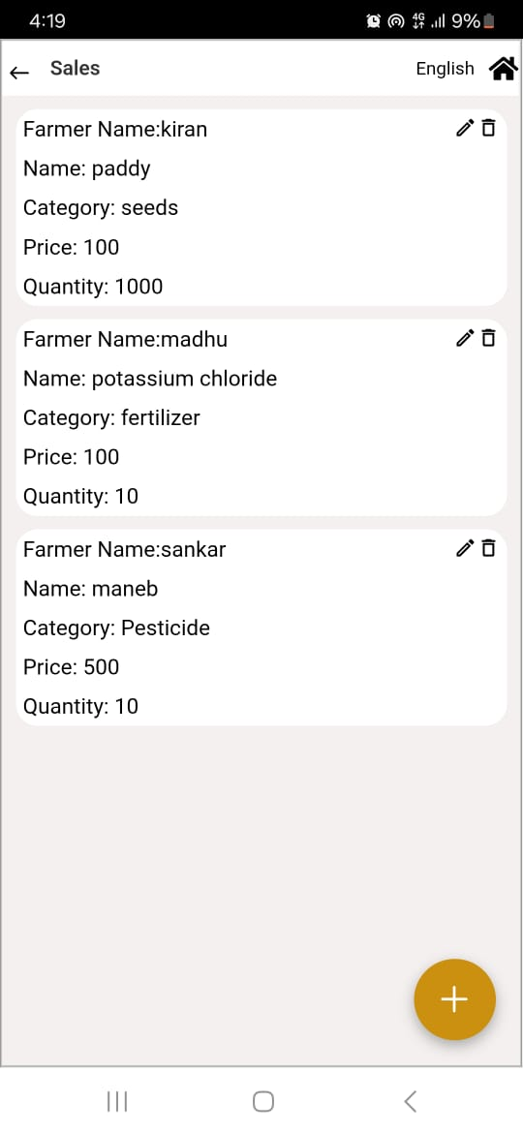
11. Kisan Connect Methodology
Module Name: Sales Management
This screen is available for RSK staff only .
Enable them to add the sales data in the mobile app which make them to access information at any time.
Allow RSK staff to keep track the sales information.
Displays available data in statistical form (summaries), making it easy for RSK staff to access and understand such as sales of products at RSK .
They can update or delete the sales data of the app.
It helps them to communicate sales information to their officials of RSK staff.

Slide 30
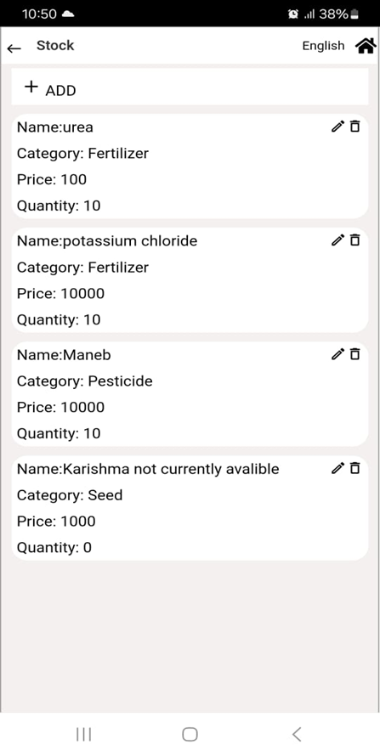
11. Kisan Connect-Methodology
Module Name: Stock Management
Main function this module is to add new fertilizer/pesticide stock.
View current stock levels, and track usage history for better planning and timely replenishment.
They fill the stock data which help in monitoring and It replace manual paper work.
The data is sent to the farmers, the they can access the real time data.
They can update or delete the details if they wanted.
This represents the stock information that is currently available at the office.

Slide 31
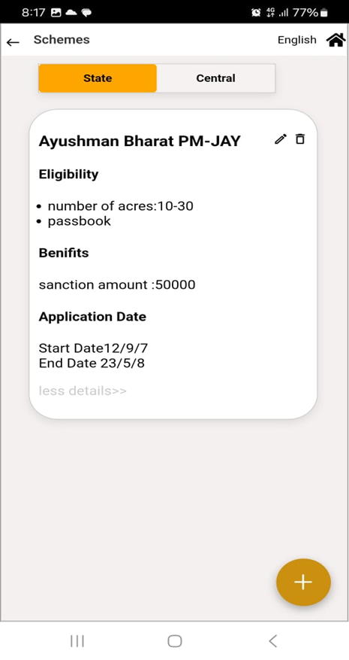
11. Kisan Connect Methodology
Module Name: Scheme Information
The officials will upload the latest scheme information released by the government into the app, which will be available to the farmers.
This enables officials to effectively communicate the latest information to all farmers.
They give eligibility and required documents are uploaded ,so farmers can come with required document to apply.
This reduces the time to spread the information of latest schemes to all farmers.

Slide 32
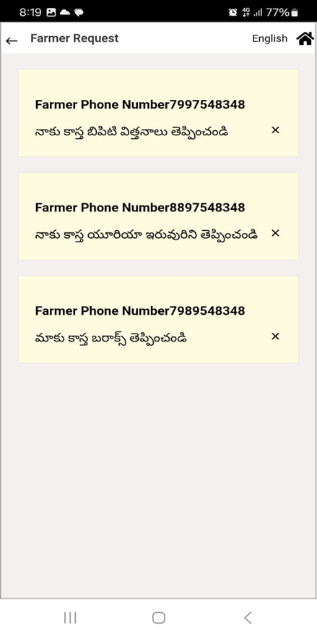
11.Kisan Connect-Methodology
Module Name: farmers Request Handling
It is one way communication where RSK staff can receive the message.
The Officials can view the requests from farmers.
The requests made by farmers can be identified by the RSK staff, allowing them to prepare the requested fertilizers and pesticides in advance.
They receive the message along with farmer details such as their Phone number.
The officials can update the stock in stock module. So the farmer can check for requested stock
If the stock is not available then can update in stock module itself that is not available or can contact the farmers also.
Upon completing the work can delete from farmer request page.

Slide 33
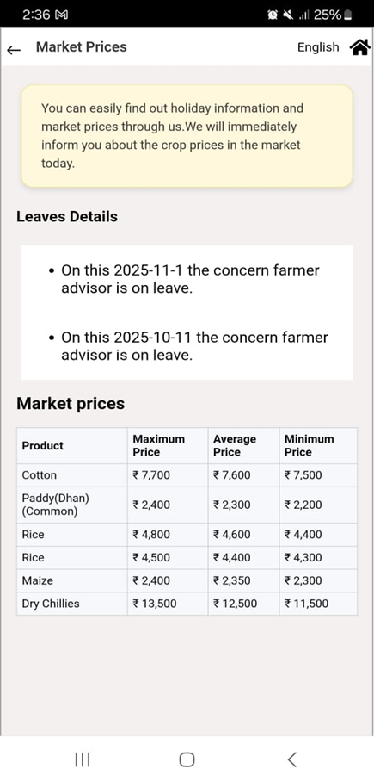
11.Kisan Connect-Methodology
Farmer Interface
Module Name: Market Access
This Screen provides farmers with up-to-date market details of agricultural products.
To achieve this, web scraping techniques are used to automatically extract real-time market price data from “www.napanta.com”.
Farmers can make informed decisions about when and where to sell their produce to get the best value for their products.
In this screen can also view when the RSK is closed in advance without contacting any one to plan their visit accordingly.

Slide 34
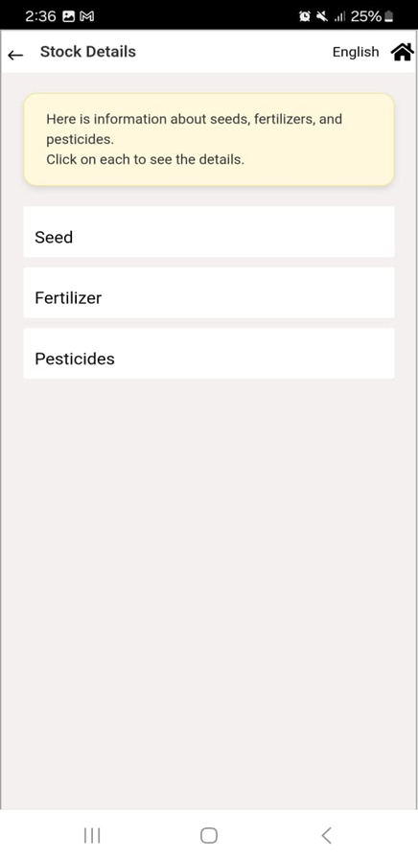
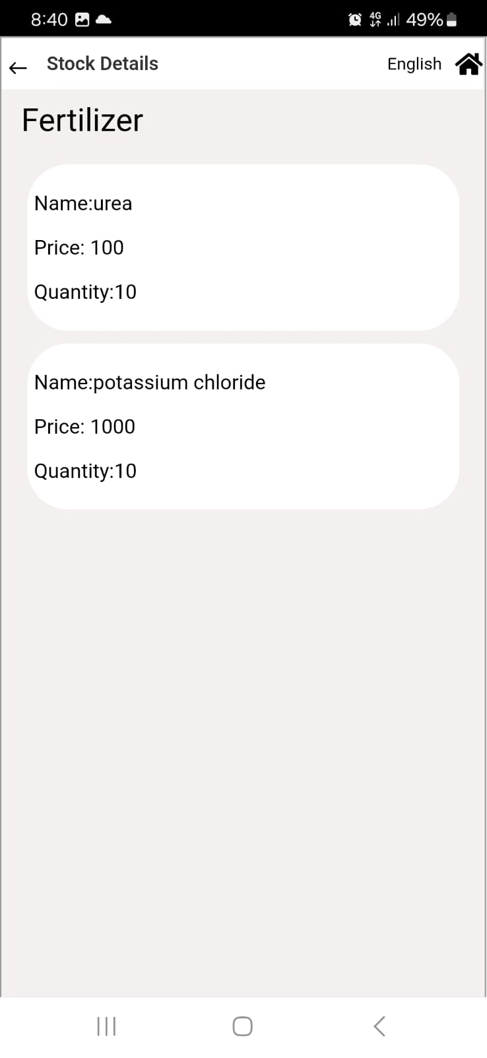
11. Kisan Connect-Methodology
Module Name: Stock Management
Farmers can view the fertilizer, pesticides and seeds in option on the screen.
Farmers can select the option and can view the details of it.
Farmers can get details of quantity, price of stock from the given data.
They have no access to update or delete the data.

Slide 35
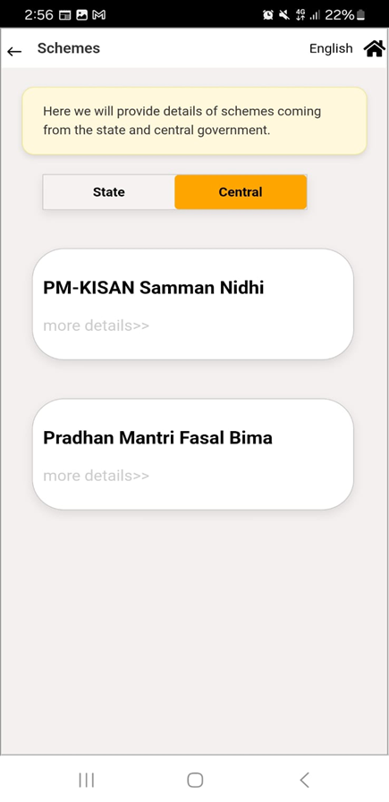
11. Kisan Connect Methodology
Module Name: Scheme Information
It helps farmers quickly find eligibility criteria, benefits, and application process.
It is categorized into Central and State Schemes.
Farmers get access to both kind of schemes.
Here all latest government schemes information is provided to farmers by RSK staff.
Farmer can check check details if it meets the eligibility criteria can get the required documents can go office for application.

Slide 36
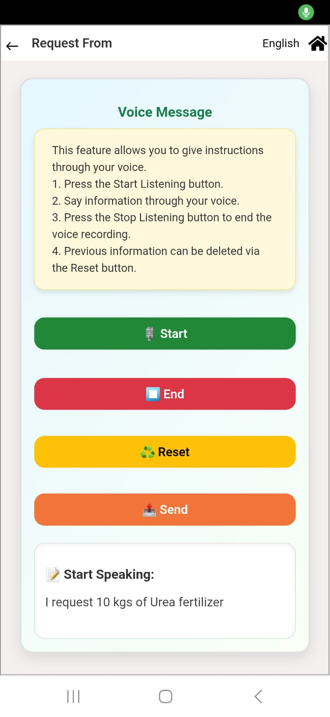
11.Kisan Connect-Methodology
Module Name: Request Form of Farmers
It is one way communication where farmers can
send the request.
Allows farmers to digitally request fertilizers/pesticides instead of manual visits.
Requests are stored in the database and ensures transparency between Farmers and RSKs, reducing delays.
Farmers can request in their local language i.e. voice assistance.
No need to write the message ,Farmers can easily send their request through their voice input and check their stock page for request resource.

Slide 37

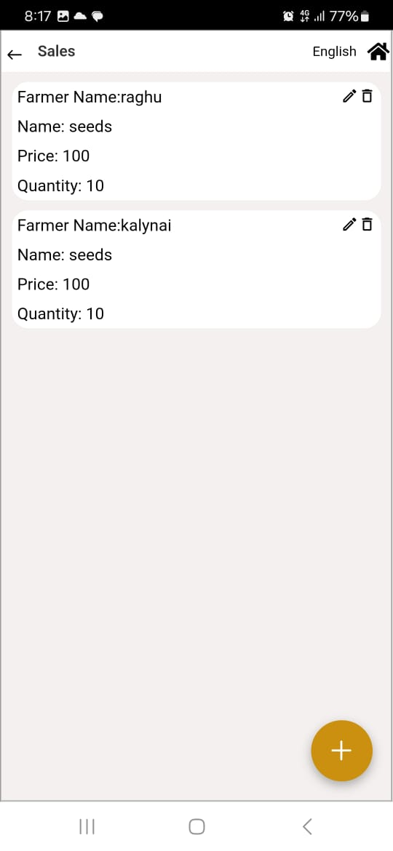

12.Results
Screenshot outputs-RSK Staff Interface
Home page Screen
Sales Screen
Stock Screen

Slide 38


12. Results
RSK Staff Interface
Schema Page
Farmer Request Page

Slide 39
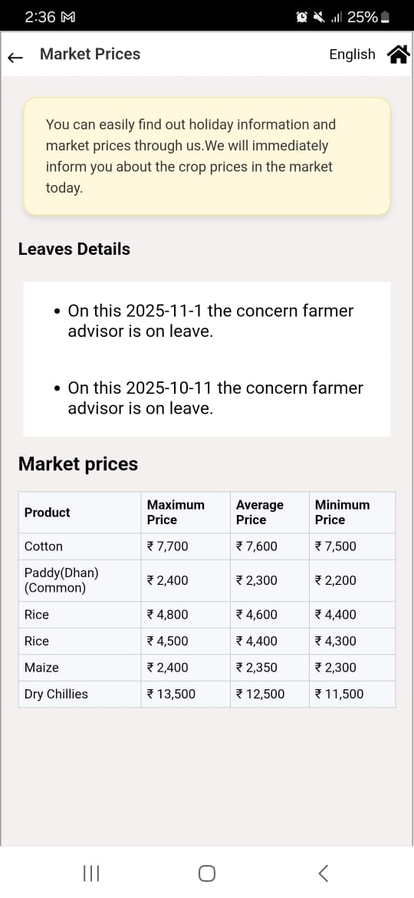

12. Results
Farmers Interface
Market Price Page
Stock Page

Slide 40

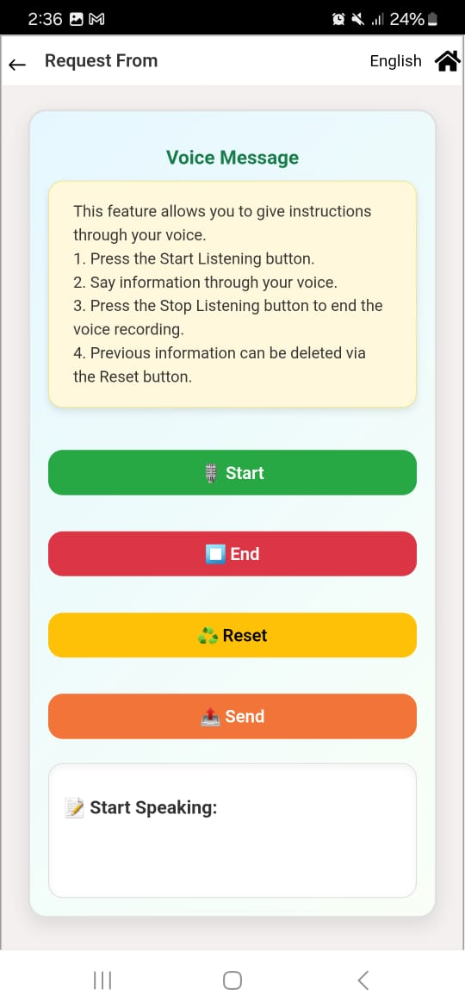
12. Results
Farmers Interface
Schema page
Request Page

Slide 41
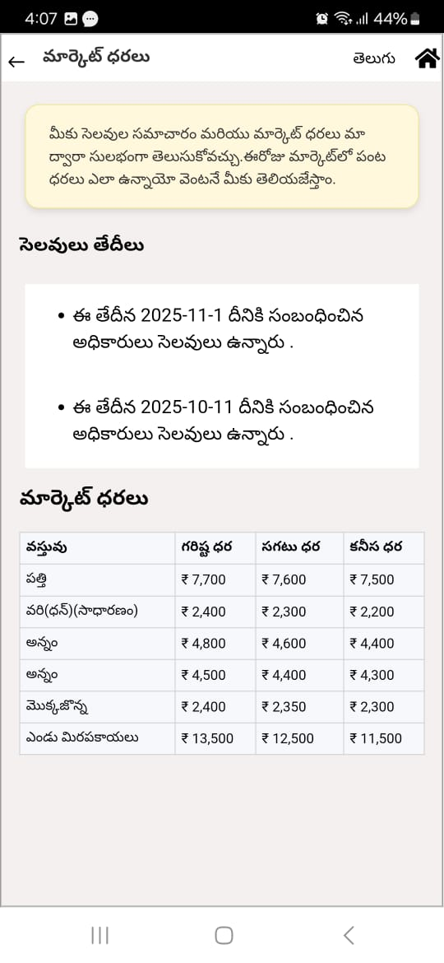
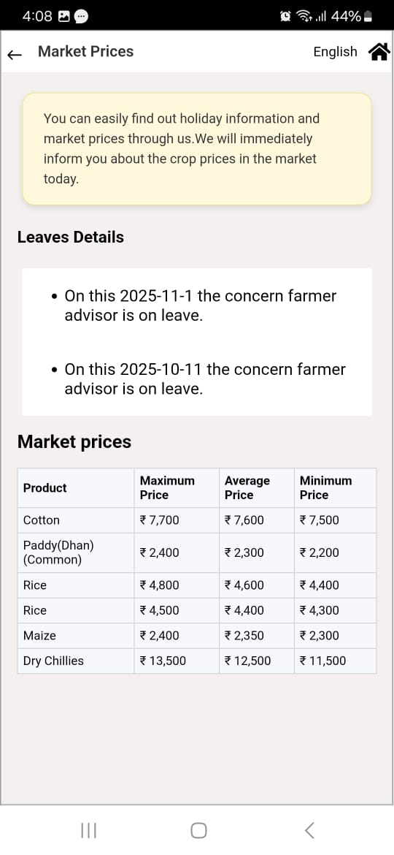
12. Results
Telugu–English Language Support

Slide 42
13. Outcome of the Project
A fully functional system has been developed and deployed as a mobile application, ensuring easy access for users on their devices.
Centralized data management allowing staff (RSK or admin users) to update and monitor stock levels (seeds, fertilizers, pesticides) in real time and sales monitoring.
Streamlined user interactions with an intuitive interface for farmers, reducing manual visits and delays in getting agricultural input information.
Offline Access for Farmers: Farmers can open and use the app even without an internet connection. Previously loaded data such as crop advisories, government scheme details, or stock availability is stored locally on their device.
Faster decision-making for administrators using real-time analytics and reports on stock availability ,Sales and scheme utilization.
Market Access: Farmers can easily access up-to-date market prices of agricultural products every day, helping them make informed selling decisions
End-to-end Digitalization: Successfully transformed manual processes into a fully digital workflow, covering stock management, farmer requests, and reporting.

Slide 43
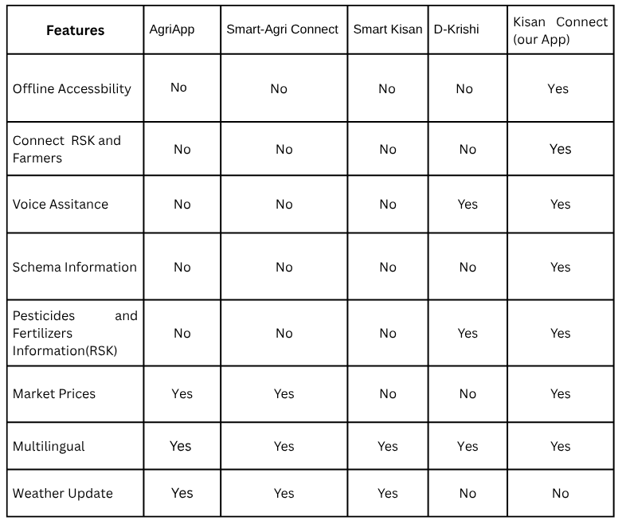
14. Comparison

Slide 44
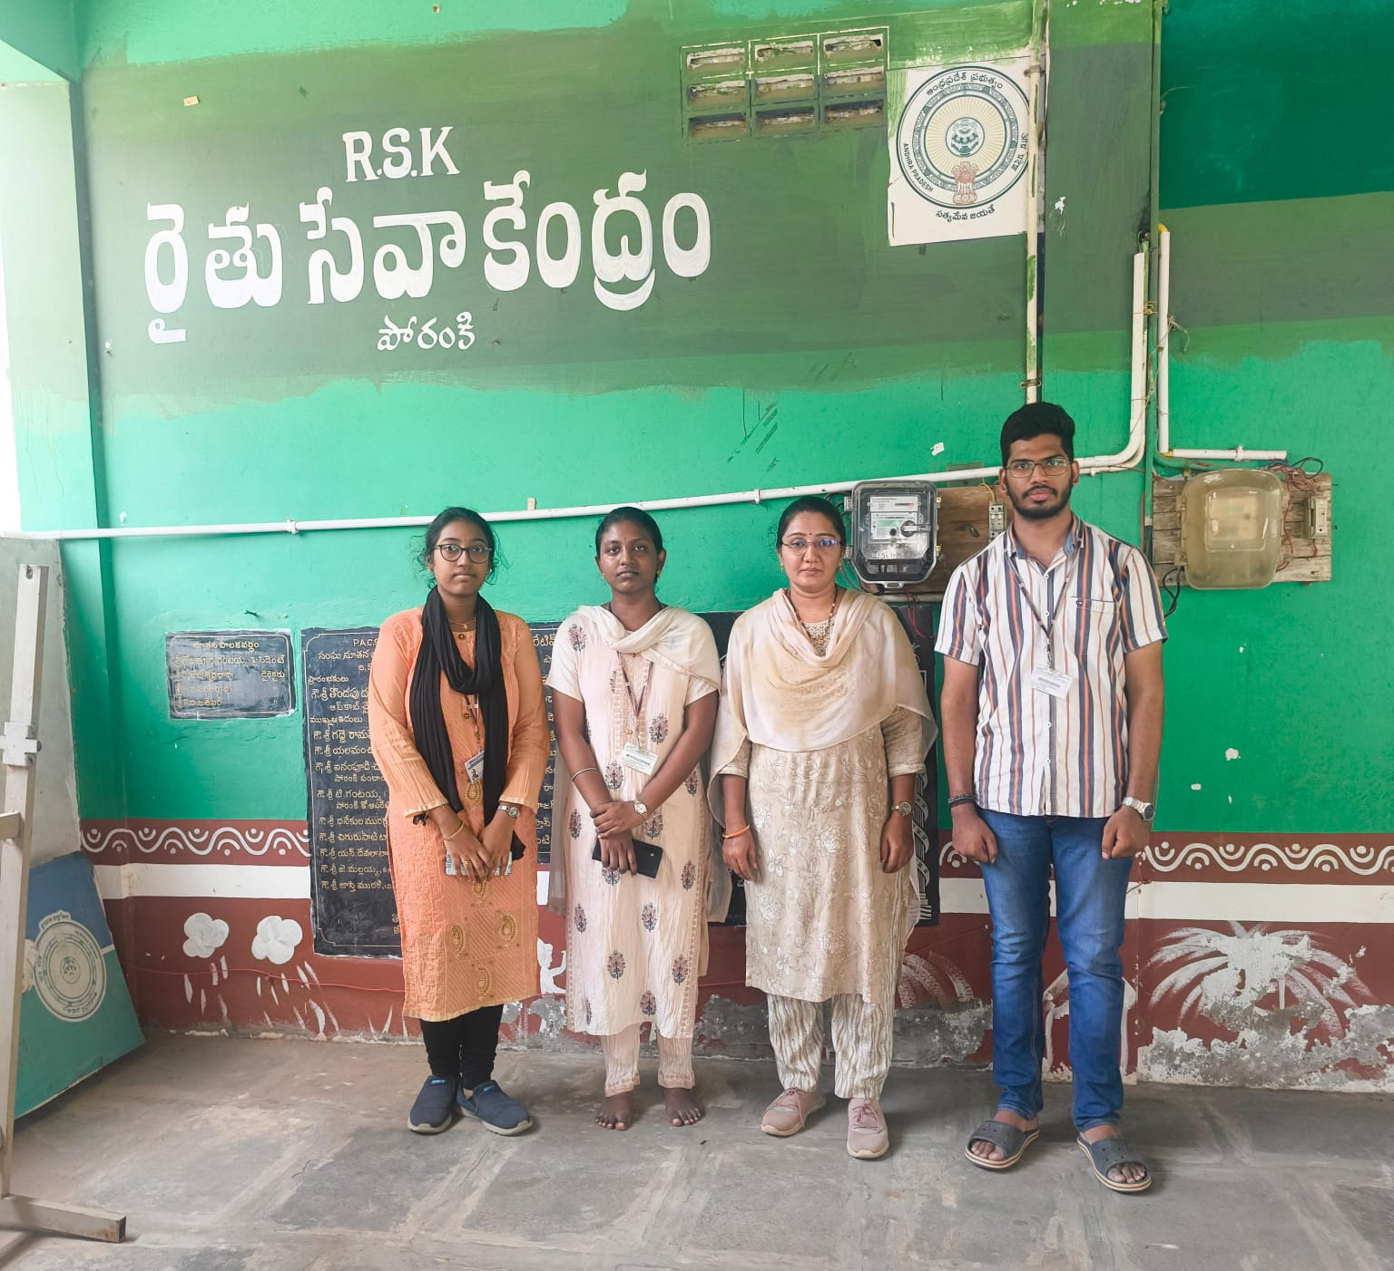
15. Client with Photograph
Name: Mrs.V.Anusha
Occupation: Village agriculture assistant
Location: Rythu Seva Kendram, Poranki, Vijayawada

Slide 45
16.Conclusion and Future Scope
KisanConnect serves as a unified mobile application bridging farmers and Rythu Seva Kendras (RSKs) by offering easy access to agricultural support, input purchase and government schemes. The system efficiently manages farmer profiles, crop details, transactions, and real-time inventory of seeds, fertilizers, and pesticides while delivering timely scheme updates, and advisory services. KisanConnect minimizes delays and paperwork, improves transparency, and empowers farmers to make informed and confident decisions. Overall, it strengthens the service delivery of RSK to farmers.
In the future, we plan to integrate map-based navigation to help farmers easily locate the nearest RSK. Additionally, SMS-based alert notifications will be introduced to ensure important updates and information reach farmers. We also include image-based searching to allow farmers to upload images and quickly retrieve relevant information. The existing app can be scaled to be implemented and deployed for usage of farmers of any region in Andhra Pradesh and also include farmer assistance through chatbot without involving officials.

Slide 46
17. References
[1] Tejal Yadav, Pooja Sable, Dhananjay Kalbande, “SMART KISAN: A Mobile App for Farmers' Assistance in Agricultural Activities,” 2023 International Conference on Smart Systems for Applications in Electrical Sciences, 2023. [Online]. Available: https://ieeexplore.ieee.org/abstract/document/10199471
[2] Vibha Srivastava, Vrishi Raj Kesarwani, Shruti Saumya, “Farming Portal: Web Based Agriculture Assistance Services,” 2024 IEEE 11th Uttar Pradesh Section International Conference on Electrical, Electronics and Computer Engineering, 2024. [Online]. Available: https://ieeexplore.ieee.org/abstract/document/10983470
[3] Lukito Edi Nugroho, Andreas Gandhi Hendra Pratama, I Wayan Mustika, Ridi Ferdiana, “Development of Monitoring System for Smart Farming Using Progressive Web App,” IEEE Conference Publication, 2017. [Online]. Available: https://ieeexplore.ieee.org/abstract/document/8250513
[4] M. Chowdhury, M. O. Rahman, and S. Alam, “Proprietor: A Farmer Assistance Smartphone Application with Crop Planner, Crop Disease Help, Agri-expert Search, and Crop Suggestion Features,” in Proceedings of the 15th International Conference on Computing Communication and Networking Technologies (ICCCNT), 2024. [Online]. Available: https://ieeexplore.ieee.org/abstract/document/10725364/authors#authors
[5] Mr.Y.Sreedhar, B.Sreenath, D.Aslam Khan, E.Deepak G.Mohith Reddy, G.BhanuTeja Reddy,“Farmer Assistant Portal,” International Research Journal of Modernization in Engineering Technology and Science, vol. 07, no. 03, Mar. 2025. [Online]. Available: https://ijisea.org/Papers/V6S1/Farmer%20Assistant%20Portal.pdf

Slide 47
17. References
[6] Divya Sawant, Anchal Jaiswal, Jyoti Singh, Payal Shah, “Agri Bot - An Intelligent Interactive Interface to Assist Farmers in Agricultural Activities,” 2019 IEEE Bombay Section Signature Conference, 2019. [Online]. Available: https://ieeexplore.ieee.org/abstract/document/8973066
[7] “D-Krishi App – Official Mobile Application from Andhra Pradesh Government,” Google Play Store. [Online]. Available: https://play.google.com/store/apps/details?id=com.org.nic.dkrishi.bio&hl=en_IN
[8] “How to Make a React Progressive Web Application,” Codica Blog. [Online]. Available: https://www.codica.com/blog/how-to-create-pwa-with-react
[9] react-speech-recognition, NPM Package Documentation. [Online]. Available: https://www.npmjs.com/package/react-speech-recognition
[10] google-translate-api-x, NPM Package Documentation. [Online]. Available: https://www.npmjs.com/package/google-translate-api-x
[11] react-i18next, Powerful Internationalization Framework for React, NPM Package Documentation. [Online]. Available: https://www.npmjs.com/package/react-i18next
[12] “Daily Market Prices – Tiruvuru, Krishna District, Andhra Pradesh,” Napanta. [Online]. Available: https://www.napanta.com/market-price/andhra-pradesh/krishna/tiruvuru
[13] “Agriculture – Role & Functionality of Department,” Krishna District Government Portal. [Online]. Available: https://krishna.ap.gov.in/agriculture-2/
[14] “Rythu Seva Kendralu – A Digital & Integrated Model for Knowledge and Service Delivery to Farmers,” Agri Conferences. [Online]. Available: https://agri-conferences.com/

Slide 48
THANK YOU

Slide 49
8. Progress Update
We have completed the frontend part with a responsive and user-friendly interface.
We have completed the farmer and RSK user interface.
We have completed the backend development, along with database and API creation.
We are focusing on the language and other features.
Voice assistant for farmers is also completed.
Offline accessibility is completed.
Direct market access to farmer feature is completed using web scraping from official websites

Slide 50
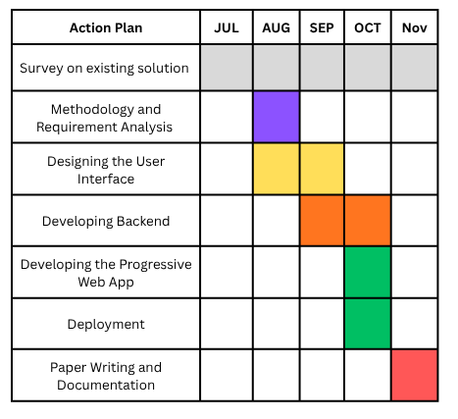
9. Progress Update

Slide 51
Technology
System Architecture:
Presentation Layer – React
Application Layer–Express+ Node.js
Database Layer –MongoDB
Methods, Tools & Techniques:
Frontend Development: React ,CSS
Backend Development: Node.js + Express.js
Database: MongoDB
Version Control: GitHub
Testing: usability testing with RSK staff and farmer.
Deployment: App (PWA) for mobile

Slide 52
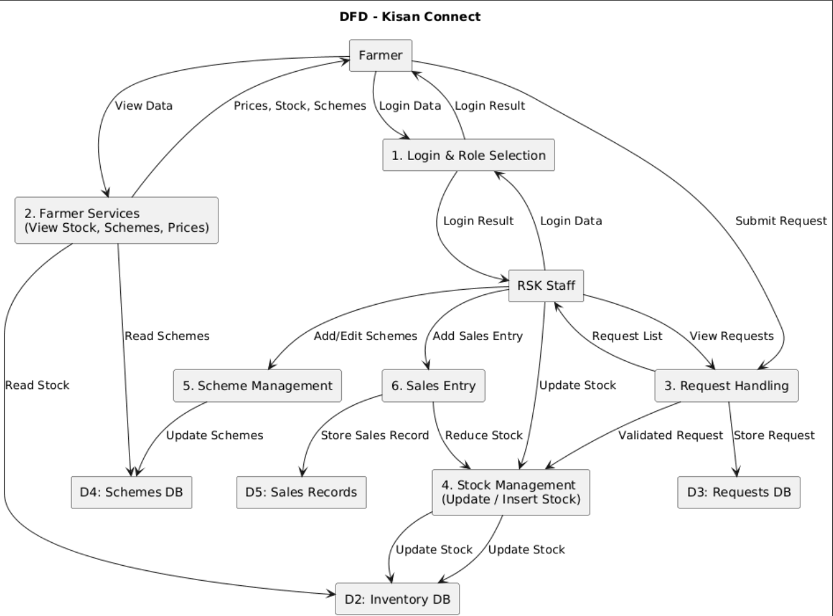
DataFlow Diagram

Slide 53
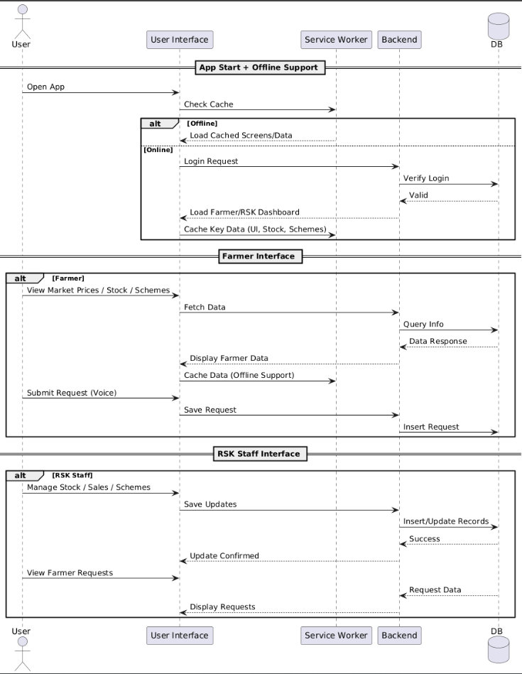
UML Diagrams-Sequence Diagram

Slide 54
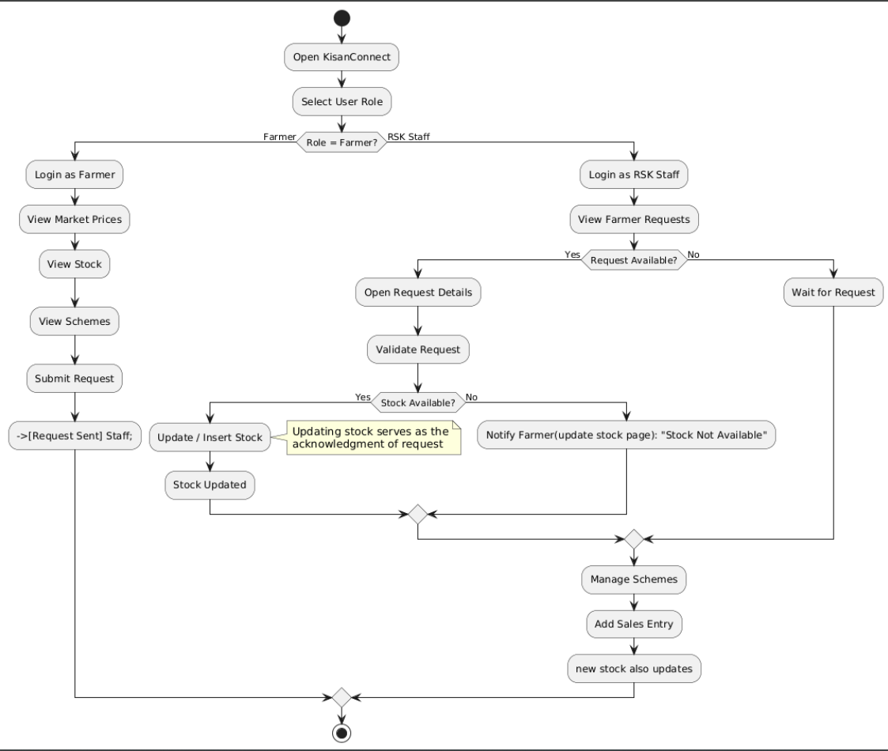
Activity Diagram

